Slide 1


Capstone Project
Marketing and Retail Analytics

Slide 2
Problem Statement
olist is an e-commerce company that has faced some losses in the recent past, now they want to manage their inventory so as to reduce unnecessary costs. In this assignment, we have to manage the inventory cost for the olist. We also need to identify the top products that contribute to the revenue and also use market basket analysis to understand the purchase pattern of individual customers to estimate with relative certainty, what items are more likely to be purchased individually or in combination with some other products.
So ultimately, we need to help olist to identify the product categories which they can get
rid of without significantly impacting business.

Slide 3
Contents
Data Understanding and Cleaning
Visualizations
Pareto Analysis
Market Basket Analysis
Conclusions & Suggestions

Slide 4
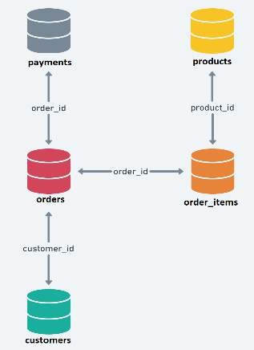
Data Understanding and
Cleaning
This is the schema of olist company:
It has 5 tables having connections with the other tables.
For this Capstone, we have to consider only
those orders where order status is delivered.

Slide 5
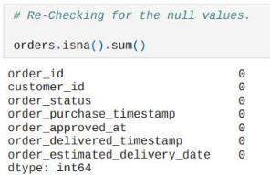
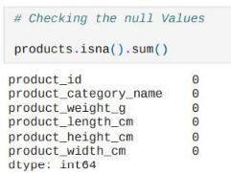
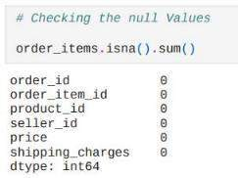
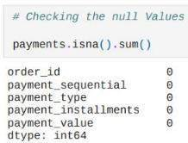
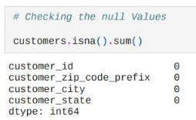
Basic EDA & Data Cleaning
All the Null Values are filled with appropriate mean and median
values and Duplicates are removed.

Slide 6
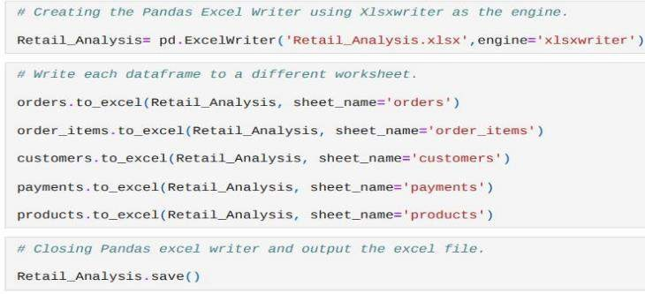
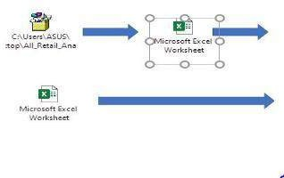
EDA
Converting the python script to Excel file using xlsxwriter engine and uploading this file to Tableau for further analysis.
This file is the combination of the order_items table and product table for Market_Basket_Analysis in Tableau.
order_id product_ca
00010242ftoys
00024acbctoys
00018f77f toys
000229ec3toys
00042b26ctoys
00048cc3ahouseware
00054e843toys
0005f5044toys
000576fe3garden_too
00061f2a7toys
0005a1a17health_bea
00063b381toys
0006ec9dbtoys
0008288aagarden_too
00097923 sports_leis
0008288aagarden_too
0009c9a17toys
000aed2e2toys
000c3e661sports_leis
000e906b7telephony
000e56288cool_stuff
000f25f4d toys
000e63d38toys
001021efatoys
0010b2e52toys
00119ff93 toys
0011d82c4toys
00125cb69toys
00130c0eetoys
0013503b furniture_d
00137e170toys
001427c0etoys
00143d0f8toys
00143d0f8toys
00143d0f8toys
0014ae671toys
0015ebb40toys
00169e31etoys
0016dfeddtoys
0017afd50toys
00186235 cool_stuff
0019c2910toys
001ab0a75toys
001ab0a75toys
001ab0a75toys
001ac194dconstructio
001b76dd4toys
001c85b5f toys
001d8f0e3toys
001d8f0e3toys
001daeb0etoys
001dbc16dtoys
001e7ba99toys
001e7cf2a toys
0020262c8furniture_d
0020a222ftoys
00217570 toys
00229e4e4toys
0025081dctoys
00254baebtoys
00259a44ftoys
0025c5d1asports_leis
002611a77toys
00269143 toys
0026a3686toys
00275bce6toys
00276d5c3toys
00283453 toys
0028de0catoys
002955b0atoys
0029c5db3toys
0029f17cf0toys
002af7fa9 toys
002b430ff toys
002b4e6fatoys
002c9def9toys
002c9def9toys
002d04001toys
002f16b7btoys
002f19a65toys
002f98c0f7toys
002f98c0f7toys
0030d783ftoys
0030ff924ctoys
00310b0c7toys
00324b3edtoys
0032d0745houseware
003324c70toys
003324c70toys
00335b686toys
00335f75etoys
00337fe25bed_bath_
00337fe25toys
003423b75toys
00345f338toys
0035246a toys
0035c0b07toys
0035e6b7atoys
00367574 toys
00368877 toys
00378c6c9toys
00382243 toys
00382243 toys
0039500dbtoys
003a7f59dtoys
003a94f77toys
003cc6161houseware
003d06342toys
003d804eewatches_g
003d9fc84toys
003edccf1 toys
003f201cdcomputers
003f201cdcomputers
003f9bcc0 toys
00404fa7awatches_g
a ys

Slide 7
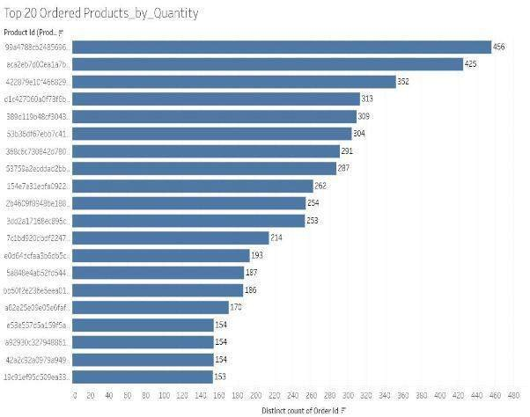
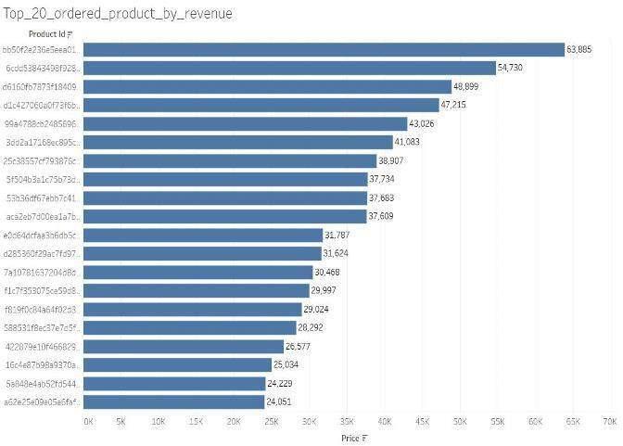
Visualization
These are the top 20 Product_id by Quantity_Ordered and Revenue.
Here we see that a Product having a maximum number of orders doesn’t have maximum
Revenue.

Slide 8
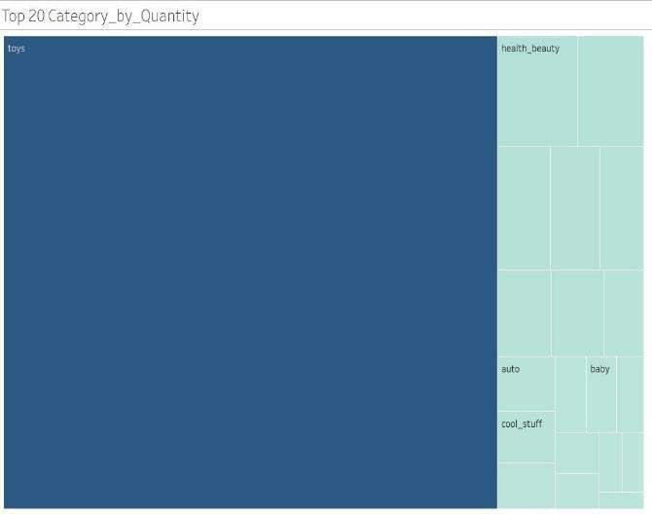
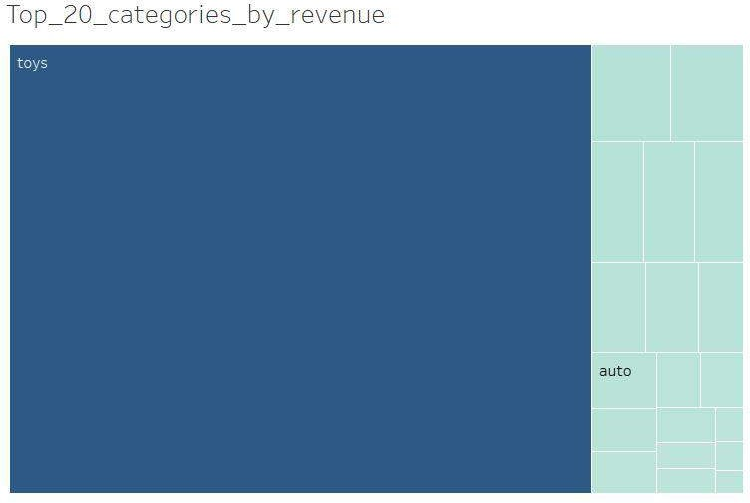
These are the top 20 product_categories by quantity_ordered and revenue.
Toy category acquires more than 75% share in Revenue as well as in Total Placed Orders.

Slide 9
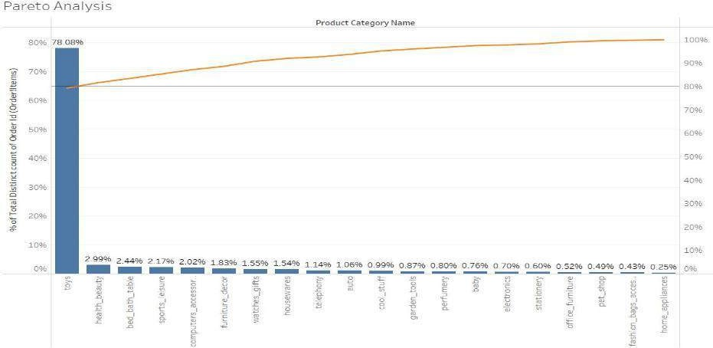
Pareto Analysis
Here we clearly see that toy category contributes 78% of the total orders and 80%(approx.) of the total revenue.

Slide 10
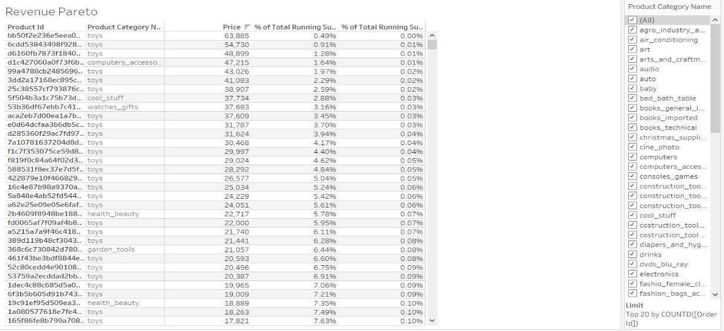
From this table, we can find the percentage running total and number of orders for every single product category.

Slide 11
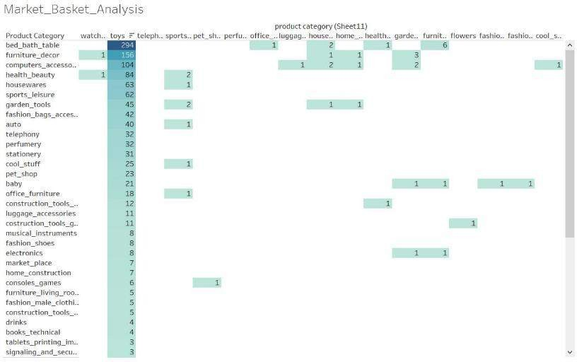
Market Basket Analysis
Toys have the highest association with the rest of the product_categories because toys occupy 76% of total orders.
Toys and bed_bath_table reflect a maximum of 294 in the matrix, which signifies that people generally buy toys and bed_bath_table together.
People tend to buy furniture_decor, computer_accessories with toys also.
Empty boxes depict 0 relations with the other products, that means they are not ordered together.

Slide 12
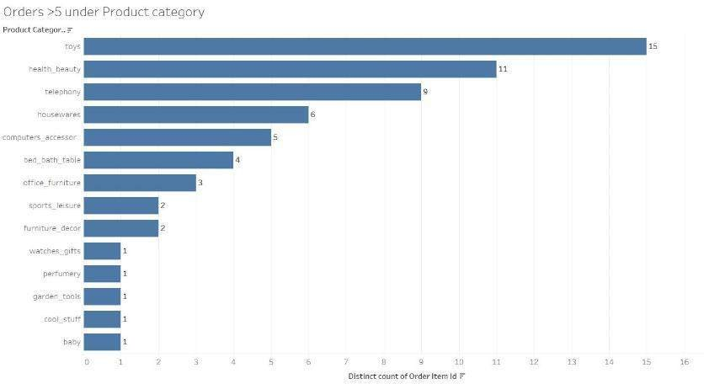
Products Ordered > 5 Times

Slide 13
Conclusions & Suggestions
We see that toys contribute maximum revenue as well as the maximum number of orders, so we should provide lucrative discounts to retain our loyal customers.
Computer Product category should be removed from the list as there are very few orders coming from the computer category but computer_accessories is very profitable from the business point of view, so it should be continued.
Fashion_Female_Clothing and Kitchen_dining_laundry are not Profitable for the business, so we should remove that also.

Slide 14
From the market basket analysis, we conclude that people buy toys and bed_bath_table very frequently. So we should provide combo offers as well as attractive schemes to retain our customers.
Audio and Music Category should be removed from the product_category as this won’t significantly impact our sales and they are very slow-moving products also.

Slide 15
Dashboards

Slide 16
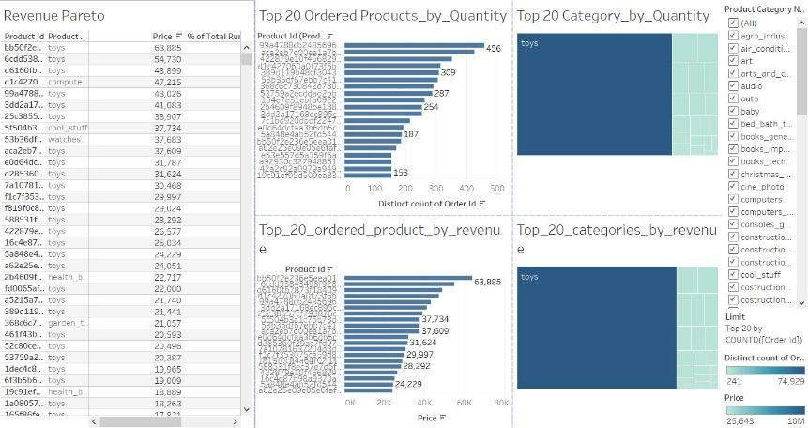
Summary Dashboard

Slide 17
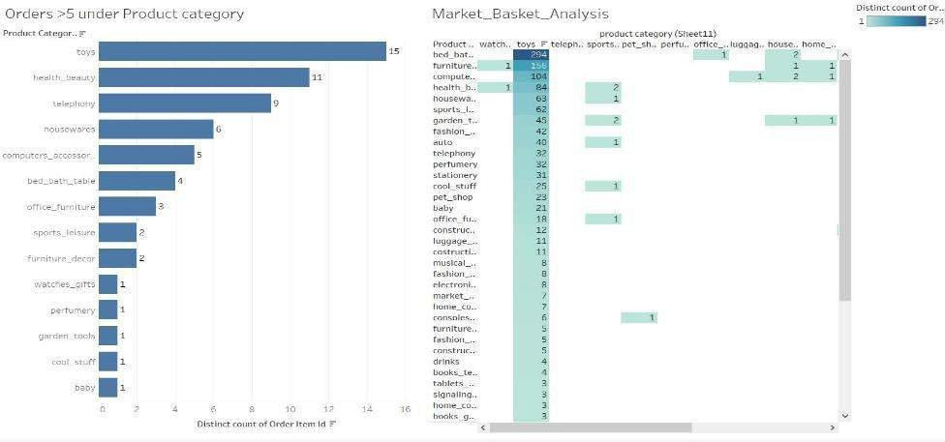
Market Basket Analysis Dashboard

Slide 18
Thankyou
Sahil Gera sunnygera1999@gmail.com

